Slide 1
Equipment Doctors
Click to
Receive 10% off your initial PM Service
Exp 4/15/2009
5546 NW Beaver Dr #400
Johnston, IA 50131
Phone: 515-238-2678
Equipdoc@yahoo.com
Monday - Friday 8 - 5
“For your equipments health and maintenance … The Doctor is in!”
Home About Us Parts & Services Shop Talk Coupon

Slide 2
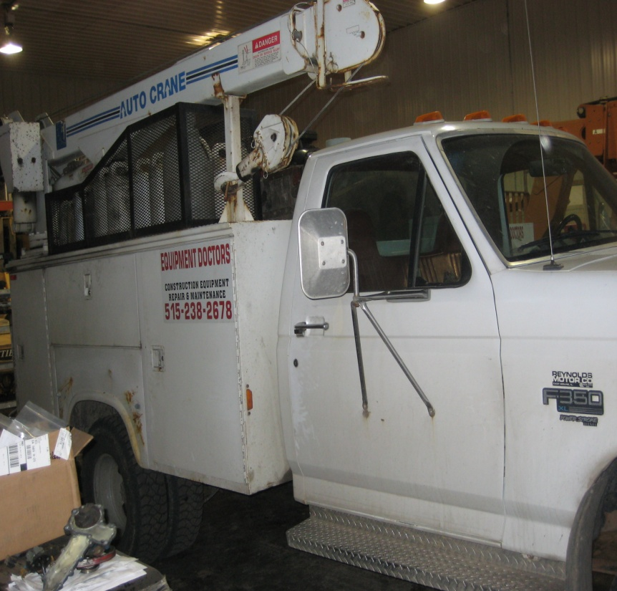
About Us
Store Hours
Open Mondays through Fridays from 8 - 5
Equipment Doctors is a mobile onsite construction equipment repair and maintenance business. Locally owned by Dave Westercamp, Equipment Doctors began almost 7 years ago in October of 2001. The business is based out of a shop in Johnston, Iowa although most business is still done onsite. Equipment Doctors offers a service to an overwhelming amount of construction equipment makes and models.
5546 NW Beaver Dr #400
Johnston, IA 50131
Phone: 515-238-2678
equipdoc@yahoo.com
Home About Us Parts & Services Shop Talk Coupon

Slide 3
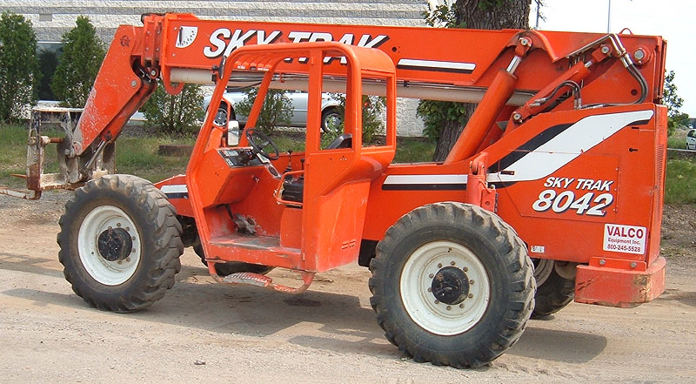
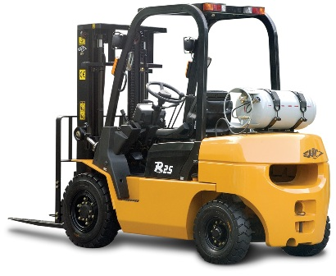
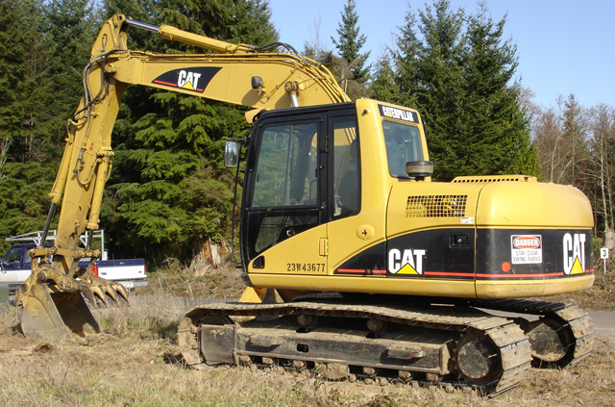
Parts & Services
Equipment Doctors not only repairs your machine it also performs routine maintenance services. They can provide transportation of your machines and fulfill your part orders.
Preventative Maintenance
Electrical repair
Hydraulics
Welding
Tire Service
Annual inspections
5546 NW Beaver Dr #400
Johnston, IA 50131
Phone: 515-238-2678
equipdoc@yahoo.com
Home About Us Parts & Services Shop Talk Coupon

Slide 4
Shop Talk
Submit Questions here for Dave to answer.
Submit
5546 NW Beaver Dr #400
Johnston, IA 50131
Phone: 515-238-2678
equipdoc@yahoo.com
Home About Us Parts & Services Shop Talk Coupon

Slide 5
Survey
Submit
About You
Name:
1. When was the last time you got your equipment serviced or repaired?
2. When was the last time you got your equipment serviced by someone other than Equipment Doctors?
3. How many times in the last 6 months have you had your equipment serviced or repaired?
4. How often have you had your equipment serviced or repaired by Equipment Doctors in the past 6 months?
5. How much do you typically spend on repairs and services in a 6 month time period ?
6. How much have you spend on equipment repairs by Equipment Doctors in the past 6 months
7. What parts manufacturer do you work with?
8. How far do you travel to get your machine repaired or serviced?
5546 NW Beaver Dr #400
Johnston, IA 50131
Phone: 515-238-2678
equipdoc@yahoo.com
Home About Us Parts & Services Shop Talk Coupon

Slide 6
Coupon
Print this coupon and receive 10% off your initial PM service
Expires on April 15, 2009
Print this Coupon and receive 10% off your initial PM service
Print
Phone: 515-238-2678
www.equipmentdoctors.com
5546 NW Beaver Dr. #400
Johnston, Iowa 50131
5546 NW Beaver Dr #400
Johnston, IA 50131
Phone: 515-238-2678
www.equipmentdoctors.com
Home About Us Parts & Services Shop Talk Coupon

Slide 7
Hot Links
Napa Auto Parts -
http://www.napaonline.com/
R&R Towing - http://desmoines.citysearch.com/profile/3249441/johnston_ia/r_r_towing_corporation.html
Advantage Homes –
http://www.advantagehomesllc.com/
5546 NW Beaver Dr #400
Johnston, IA 50131
Phone: 515-238-2678
www.equipmentdoctors.com
Home About Us Parts & Services Shop Talk Coupon

